Slide 1
Data Analystic on crime data
Guide By
Prof. Speril Demello Hemangi Jadhav 65
Pranjal Mane 68
Manasvi Mhatre 69

Slide 2
Objective
Understanding crime pattern
Classify crime based on location
Methodology
Machine learning

Slide 3
Language
Python
Jupyter and Flask
Technology
Visual Data Analysis
Algorithm
KNN (K-Nearest neighbors)

Slide 4
Visual Data Analysis
Need only little or preferably no coding
Make it simple to locate and bring in data from different sources
Offer graphics that are easy to customize
Make it easy to drill down to the underlying data at any level of detail
Make it possible to combine multiple views for at-a-glance, overall understanding

Slide 5
Dataset
Incident number
Category of crime
Description of crime
Data / Time
District
Resolution
Address

Slide 6
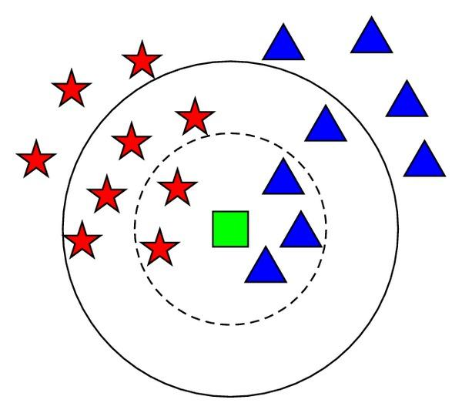
KNN (K-Nearest neighbors)
Fig. Principle diagram of KNN

Slide 7
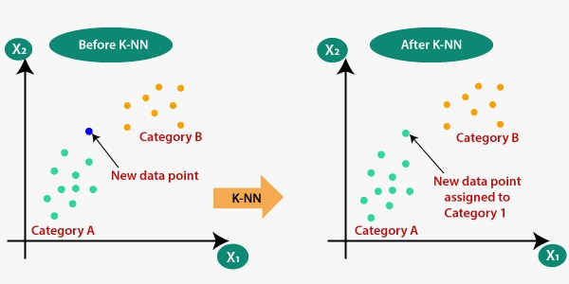

Slide 8
Algorithm
Step-1: Select the number K of the neighbors
Calculate the Euclidean distance of K number of neighbors
Take the K nearest neighbors as per the calculated Euclidean distance.
Among these k neighbors, count the number of the data points in each category.
Assign the new data points to that category for which the number of the neighbor is maximum.
Our model is ready.

Slide 9
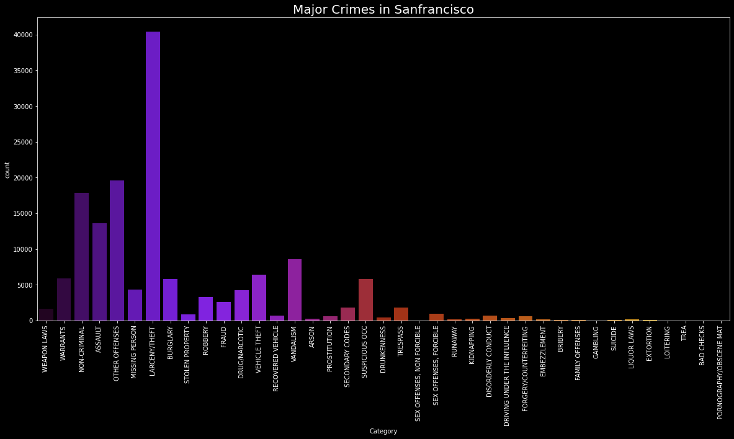
Output of Analysis

Slide 10
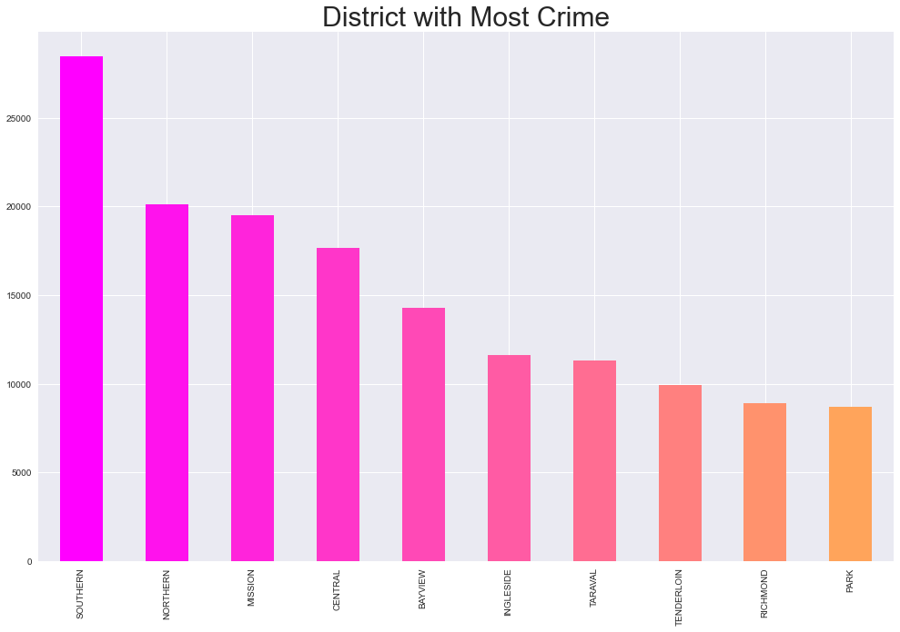

Slide 11
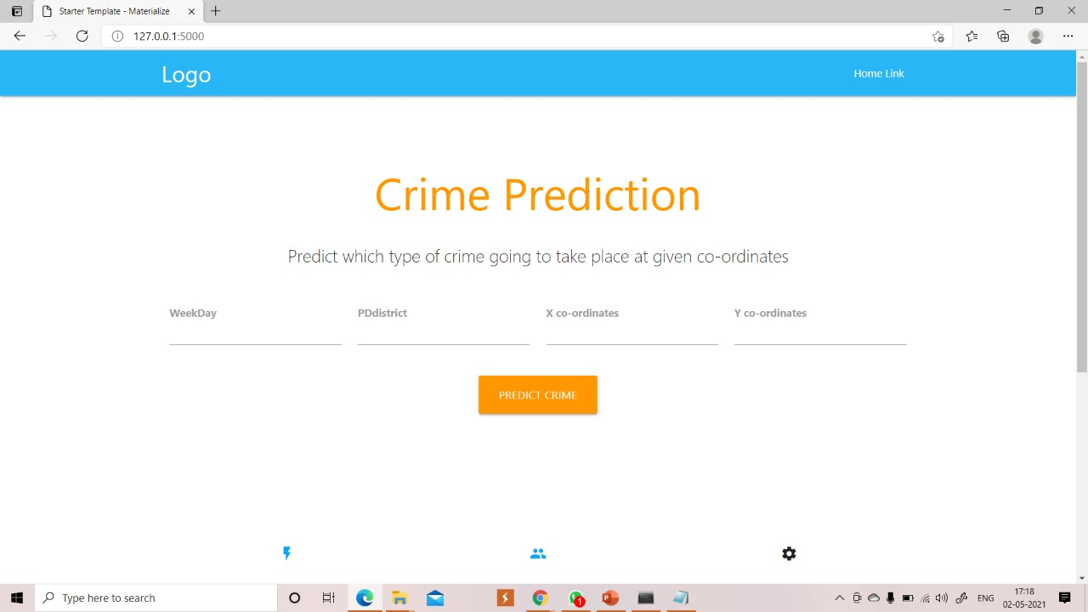
Output of Prediction

Slide 12
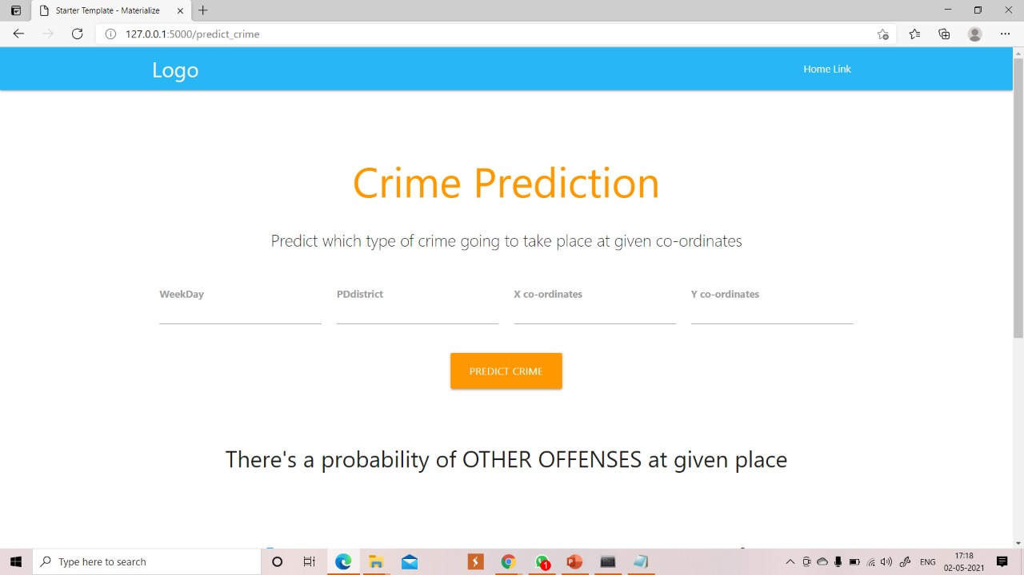

Slide 13
Future Scope
we can also predict the estimated time for the crime to take place as a future scope. Along with this,
We can also try to predict the location of the crime.
We will test the accuracy of frequent-itemsets and prediction based on different test sets. So the system will automatically learn the changing patterns in crime by examining the crime patterns. Also the crime factors change over time.
By shifting through the crime data we have to identify new factors that lead to crime. Since we are considering only some limited factors full accuracy cannot be achieved. For getting better results in prediction we have to find more crime attributes.

Slide 14
Reference
https://www.kaggle.com/roshansharma/sanfrancisco-crime-analysis
https://www.irjet.net/archives/V7/i6/IRJET-V7I624.pdf
https://www.ojp.gov/pdffiles1/Digitization/137374NCJRS.pdf
https://data.gov.in/resources/crime-head-wise-crime-against-foreigners-during-2018
https://www.kaggle.com/datasets?search=crime+data+set
https://medium.com/techcrush/how-to-deploy-your-ml-model-in-jupyter-notebook-to-your-flask-app-d1c4933b29b5
https://www.datacamp.com/community/tutorials/pickle-python-tutorial

